Slide 1





It’s difficult
The participants:
Makeeva A., Grechushkina M., Kononenko A., Egorov A.

Slide 2
An aircraft selection
Aircraft model | BOMBARDIER GLOBAL 5500 | DASSAULT FALCON 6X | GULFSTREAM V | BUSINESS JET G800
Cruising speed, km/h | 956 | 850 | 851 | 950
Flight range, m | 10 556 | 10 186 | 11 903 | 14 816
Maximum number of passengers (optimal) | 16 (8) | 18 (16) | 19 (14) | 19 (13)
Aircraft length, m | 29.5 | 25.68 | 29.39 | 30.4
Aircraft height, m | 7.8 | 7.47 | 7.87 | 7.78
Wingspan, m | 28.7 | 25.94 | 28.50 | 31.39
Cabin length, m | 12.41 | 12.31 | 13.39 | 14.27
Interior width, m | 2.41 | 2.58 | 2.24 | 2.49
Cabin height, m | 1.88 | 1.98 | 1.88 | 1.91
Price, $m | 46 | 47 | 29.5 | 71.5
Manufacturer country | Canada | France | USA | USA

Slide 3
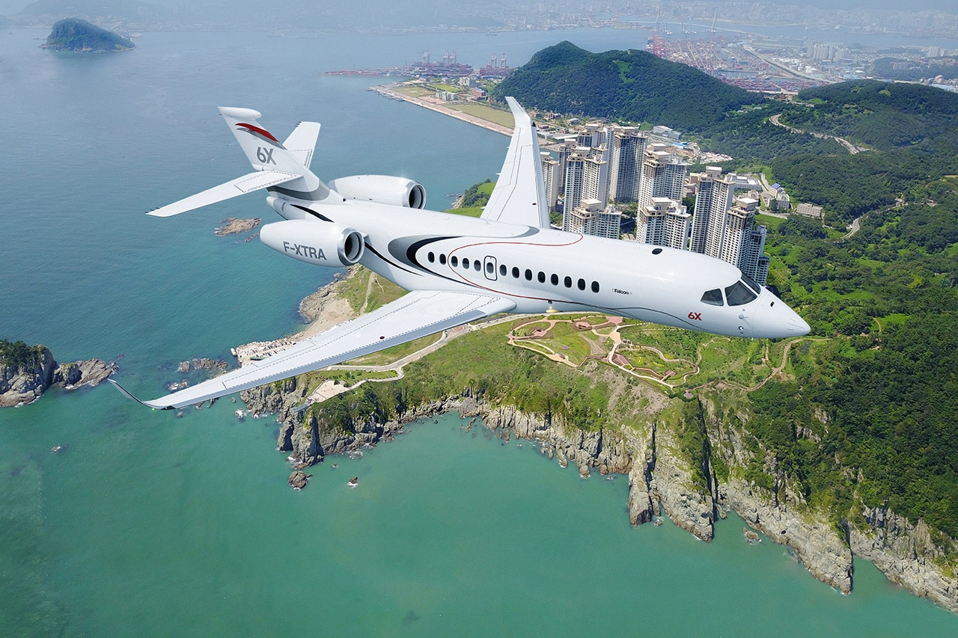
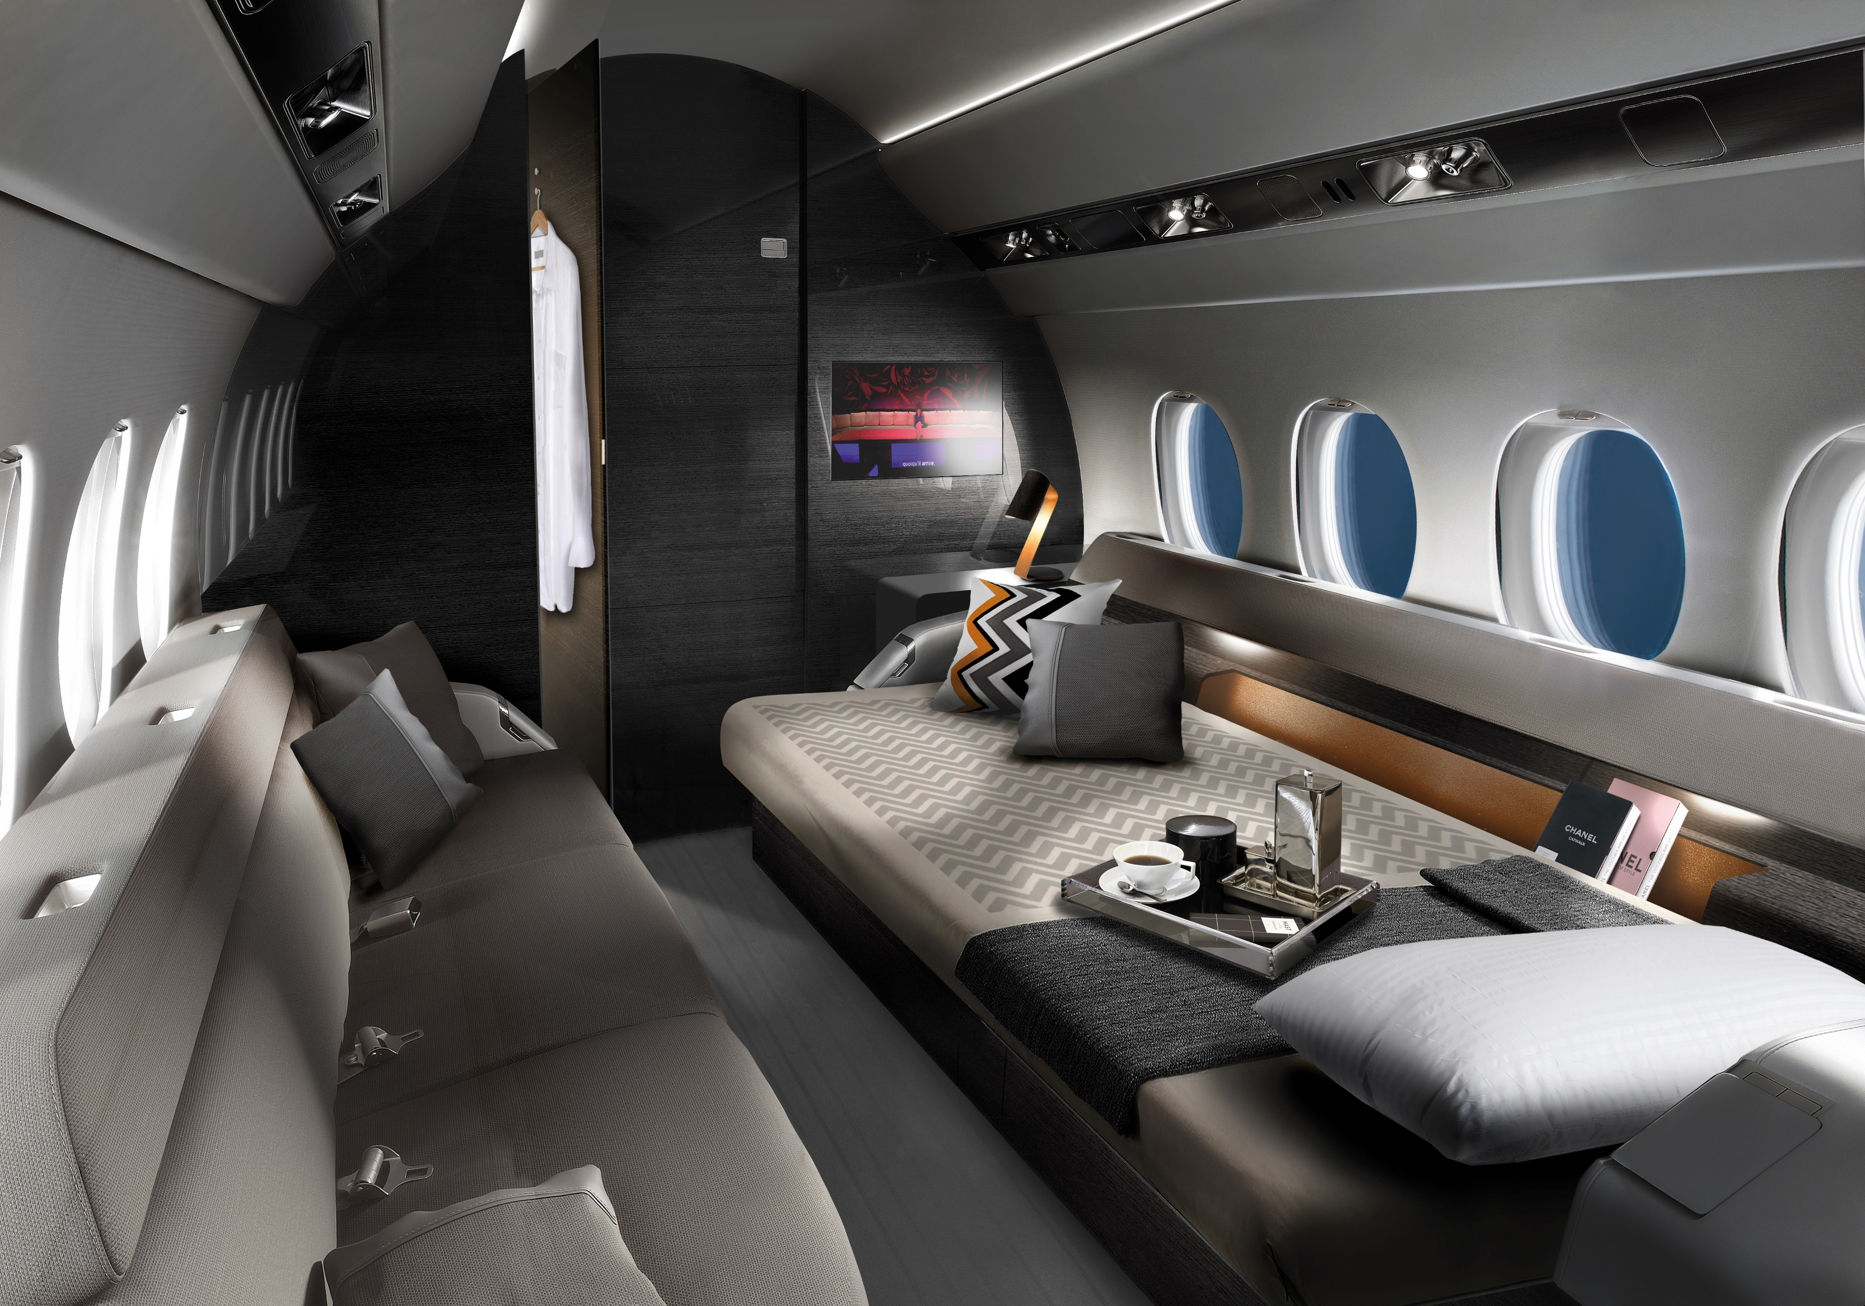
DASSAULT FALCON 6X
The appearance of the aircraft
The interior view of the aircraft

Slide 4
Severe injuries in the listed emergencies
Forest fires
Earthquakes
Floods
Hypothermia
Fractures and bruises;
Bleeding;
Head and spine injuries;
Loss of consciousness;
Respiratory arrest.
Burns;
Overheating;
Carbon monoxide poisoning.
Repeated drowning

Slide 5
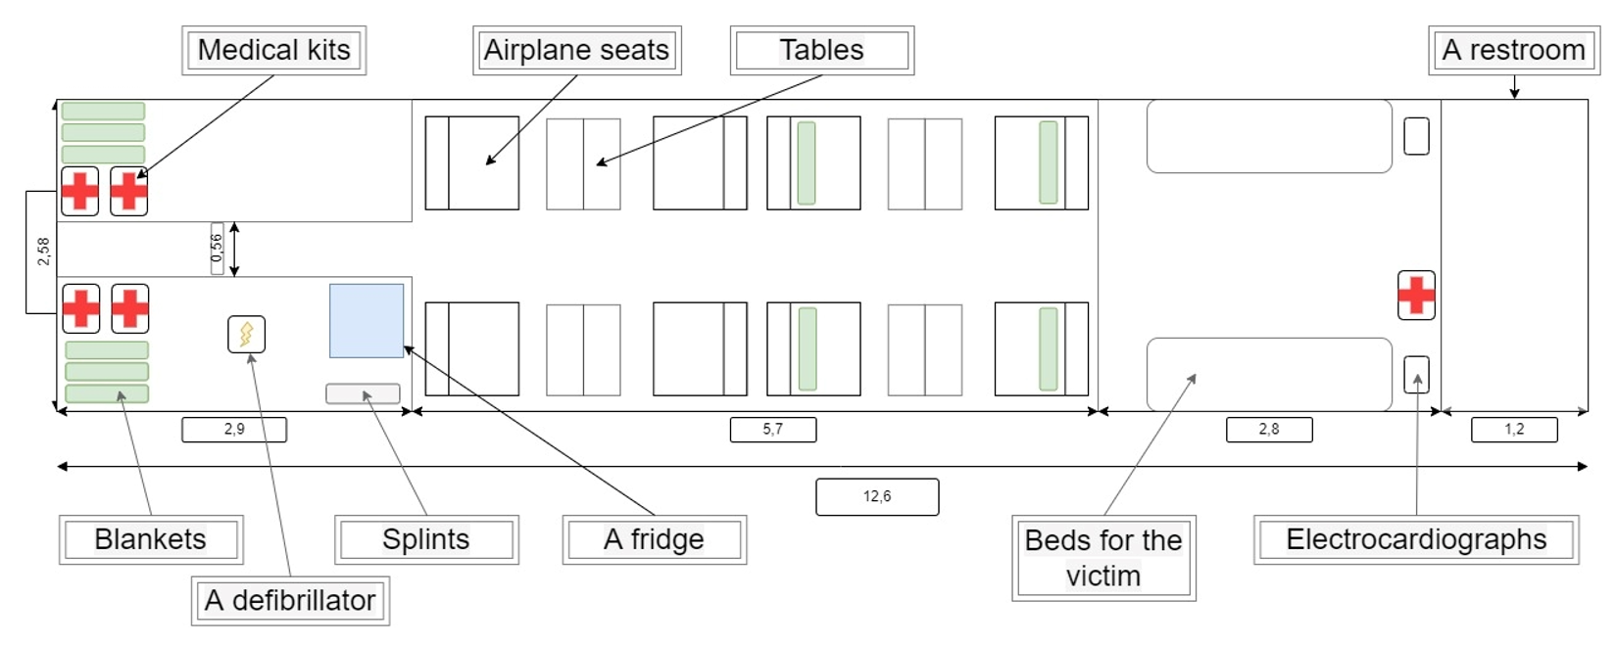
Layout of the aircraft cabin
Weight: 1140 kg

Slide 6


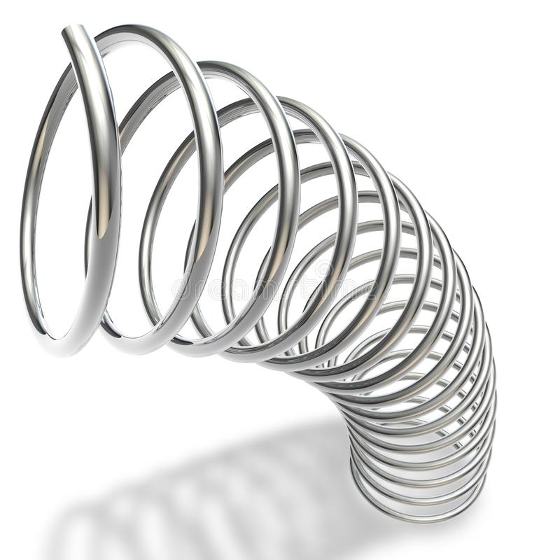
A system for reducing flight loads
REQUIREMENTS
For maneuvers | For construction | For materials
A smooth ascent and | The system of automation during shaking | Using of porous media
A smooth descent to the ground | Changing the geometry | Using of suspended liquids

Slide 7
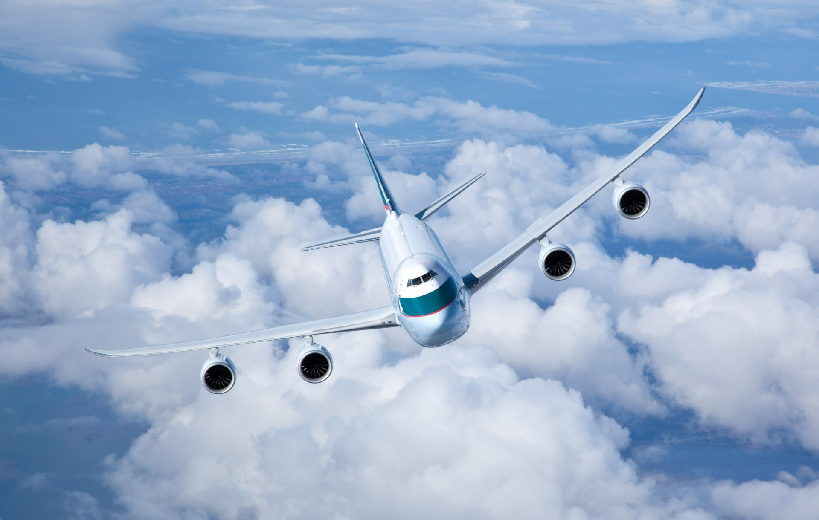

Thanks for attention!

